Slide 1
E-Commerce Sales Analysis
(Financial Data Analysis using Python) Neelam Rajput Msc. Data Science |2024-2026

Slide 2



| Project Objectives

Slide 3
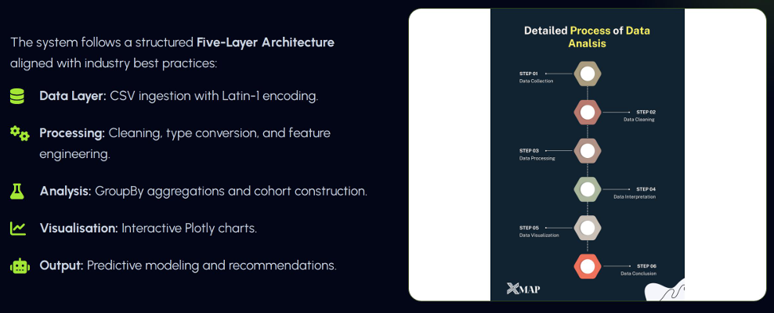
| Analytical Pipeline

Slide 4
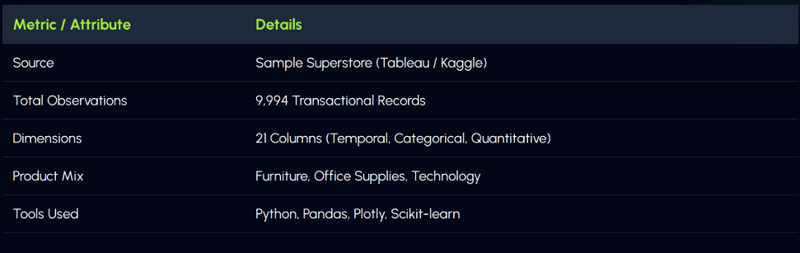
| Dataset Characteristics

Slide 5
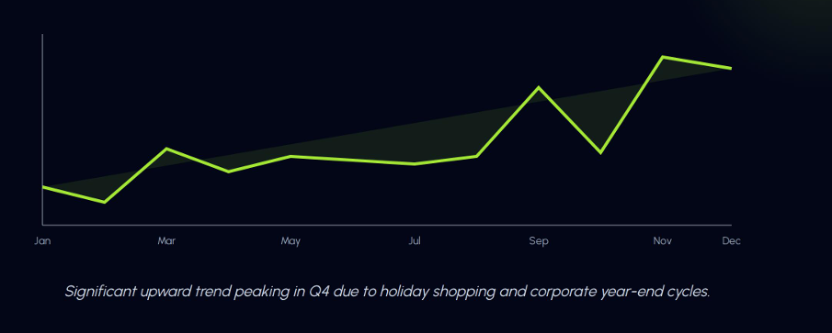
| Monthly Sales Analysis

Slide 6
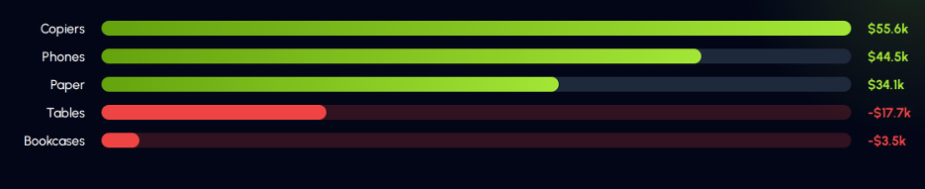
| Sub-Category Profitability
| Alert: Negative margins in “Tables” and “Bookcases” indicate a failure in pricing/discount alignment, while “Copiers” remains the efficiency driver.

Slide 7
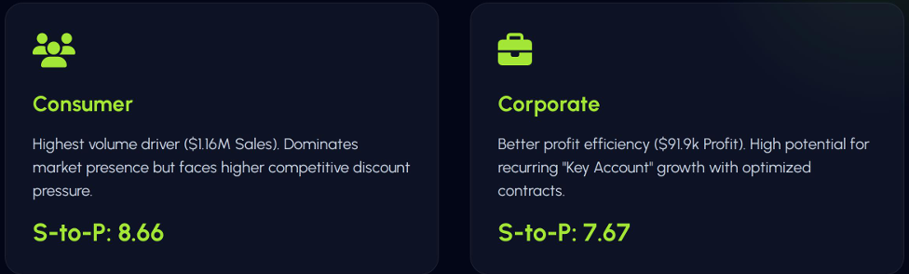
| Customer Segment Performance
Sales-to-Profit Ratio measures how many dollars sales required to generate $1 profit.

Slide 8
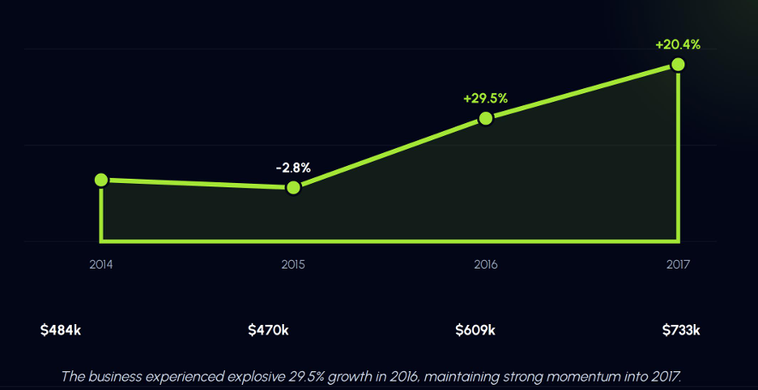
| Annual Sales & YOY Growth

Slide 9
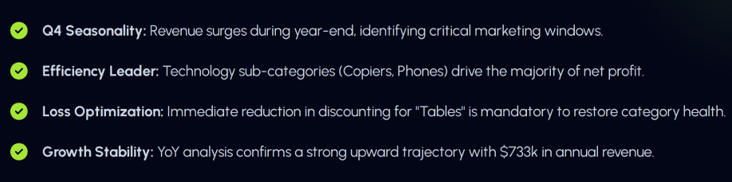
| Key findings

Slide 10
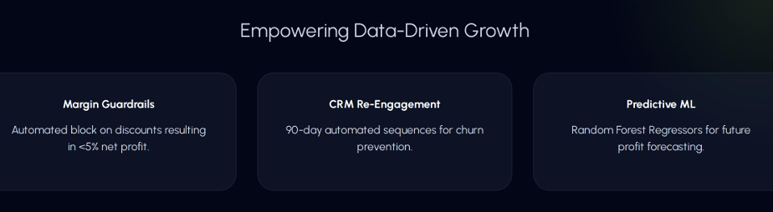
| Recommendations

Slide 11
Thank You

